Slide 1

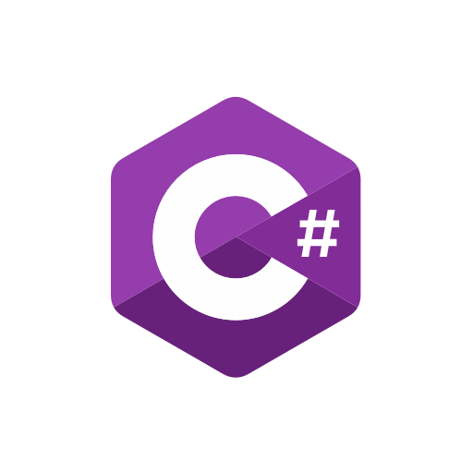
Introduction to C# programming

Slide 2

Hello!
I am Bara’a Ageel
I am here to share and exchange experience with you ,friends. You can find me at:
ageelbaraa@gmail.com

Slide 3

1.
Basic Concepts
What is C#?

Slide 4
C# is an elegant object-oriented language that enables developers to build a variety of secure and robust applications that run on the .NET Framework. You can use C# to create Windows applications, Web services, mobile applications, client-server applications, database applications, and much, much more.

Slide 5
You will learn more about these concepts in the upcoming lessons!

Slide 6
The .NET Framework
The .NET Framework consists of the Common Language Runtime (CLR) and the .NET Framework class library.
The CLR is the foundation of the .NET Framework. It manages code at execution time, providing core services such as memory management, code accuracy, and many other aspects of your code.

Slide 7
The .NET Framework
The class library is a collection of classes, interfaces, and value types that enable you to accomplish a range of common programming tasks, such as data collection, file access, and working with text.
C# programs use the .NET Framework class library extensively to do common tasks and provide various functionalities.

Slide 8
These concepts might seem complex, but for now just remember that applications written in C# use the .NET Framework and its components.

Slide 9
BIG CONCEPT
C# applications run : on the .NET Framework .
The .NET Framework consists of the Common Language Runtime (CLR) and the .NET Framework class library.

Slide 10
1.
Basic Concepts
Variables

Slide 11
Variables
Programs typically use data to perform tasks.
Creating a variable reserves a memory location, or a space in memory, for storing values. It is called variable because the information stored in that location can be changed when the program is running.
To use a variable, it must first be declared by specifying the name and data type.

Slide 12
Variables
A variable name, also called an identifier, can contain letters, numbers and the underscore character (_) and must start with a letter or underscore.
Although the name of a variable can be any set of letters and numbers, the best identifier is descriptive of the data it will contain. This is very important in order to create clear, understandable and readable code!

Slide 13
For example, firstName and lastName are good descriptive variable names, while abc and xyz are not.

Slide 14
Variable Types
A data type defines the information that can be stored in a variable, the size of needed memory and the operations that can be performed with the variable. For example, to store an integer value (a whole number) in a variable, use the int keyword:
The code above declares a variable named MyLength of type integer.

Slide 15
A line of code that completes an action is called a statement. Each statement in C# must end with a semicolon.

Slide 16


Variable Types
You can assign the value of a variable when you declare it:
or later in your code:
Remember that you need to declare the variable before using it.

Slide 17
Built-in Data Types
There are a number of built-in data types in C#. The most common are: int - integer. float - floating point number. double - double-precision version of float. char - a single character. bool - Boolean that can have only one of two values: True or False. string - a sequence of characters.

Slide 18
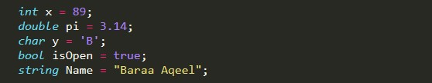
Built-in Data Types
The statements below use C# data types:

Slide 19
Note that : char values are assigned using single quotes and string values require double quotes. You will learn how to perform different operations with variables in the upcoming lessons!

Slide 20
Your First C# Program
To create a C# program, you need to install an integrated development environment (IDE) with coding and debugging tools. We will be using Visual Studio Community Edition, which is available to download for free.

Slide 21
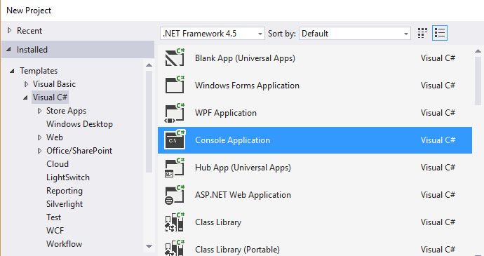
After installing it, choose the default configuration. Next, click File->New->Project and then choose Console Application as shown below:
Enter a name for your Project and click OK.

Slide 22
Console application uses a text-only interface. We chose this type of application to focus on learning the fundamentals of C#.

Slide 23
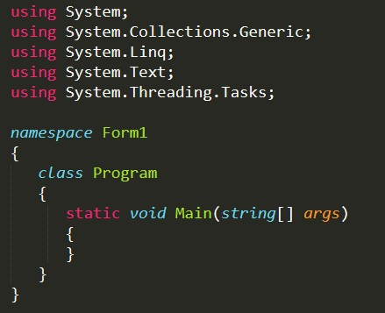
Your First C# Program
Visual Studio will automatically generate some code for your project:
You will learn what each of the statements does in the upcoming lessons. For now, remember that every C# console application must contain a method (a function) named Main.

Slide 24
Main is the starting point of every application, i.e. the point where our program starts execution from.
We will learn about classes, methods, arguments, and namespaces in the upcoming lessons.

Slide 25
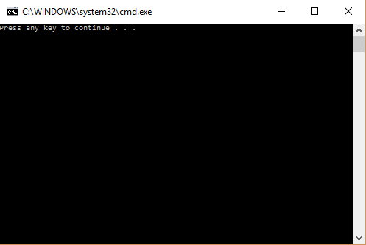
Your First C# Program
To run your program, press Ctrl+F5. You will see the following screen:
This is a console window. As we did not have any statements in our Main method, the program just produces a general message. Pressing any key will close the console.

Slide 26
1.
Basic Concepts
Printing Text

Slide 27
Displaying Output
Most applications require some input from the user and give output as a result. To display text to the console window you use the Console.Write or Console.WriteLine methods. The difference between these two is that Console.WriteLine is followed by a line terminator, which moves the cursor to the next line after the text output.

Slide 28
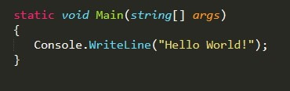
Displaying Output
The program below will display Hello World! to the console window:

Slide 29
Note the parentheses after the WriteLine method. This is the way to pass data, or arguments, to methods. In our case WriteLine is the method and we pass "Hello World!" to it as an argument. String arguments must be enclosed in quotation marks.

Slide 30
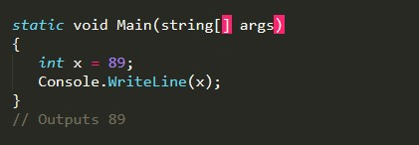
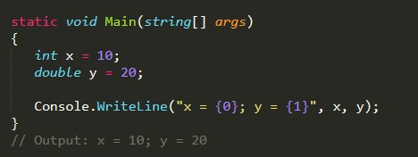
Displaying Output
We can display variable values to the console window:
To display a formatted string, use the following syntax:

Slide 31
As you can see, the value of x replaced {0} and the value of y replaced {1}.
You can have as many variable placeholders as you need. (i.e.: {3}, {4}, etc.).

Slide 32
1.
Basic Concepts
Getting User Input

Slide 33
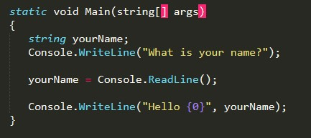
User Input
You can also prompt the user to enter data and then use the Console.ReadLine method to assign the input to a string variable. The following example asks the user for a name and then displays a message that includes the input:

Slide 34
Note the empty parentheses in the ReadLine method. This means that it does not take any arguments.

Slide 35
User Input
The Console.ReadLine method waits for user input and then assigns it to the variable. The next statement displays a formatted string containing Hello with the user input. For example, if you enter David, the output will be Hello David.

Slide 36
User Input
The Console.ReadLine() method returns a string value. If you are expecting another type of value (such as int or double), the entered data must be converted to that type. This can be done using the Convert.ToXXX methods, where XXX is the .NET name of the type that we want to convert to. For example, methods include Convert.ToDouble and Convert.ToBoolean.

Slide 37
User Input
For integer conversion, there are three alternatives available based on the bit size of the integer: Convert.ToInt16, Convert.ToInt32 and Convert.ToInt64. The default int type in C# is 32-bit.

Slide 38
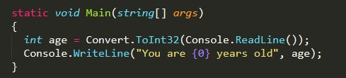
User Input
Let’s create a program that takes an integer as input and displays it in a message:

Slide 39
If, in the program above, a non-integer value is entered (for example, letters), the Convert will fail and cause an error.

Slide 40
1.
Basic Concepts
Comments

Slide 41

Comments
Comments are explanatory statements that you can include in a program to benefit the reader of your code. The compiler ignores everything that appears in the comment, so none of that information affects the result. A comment beginning with two slashes (//) is called a single-line comment. The slashes tell the compiler to ignore everything that follows, until the end of the line.

Slide 42
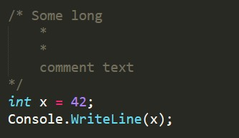
Multi-Line Comments
Comments that require multiple lines begin with /* and end with */ at the end of the comment block. You can place them on the same line or insert one or more lines between them.

Slide 43
Adding comments to your code is good programming practice. It facilitates a clear understanding of the code for you and for others who read it.

Slide 44

The var Keyword
A variable can be explicitly declared with its type before it is used. Alternatively, C# provides a handy function to enable the compiler to determine the type of the variable automatically based on the expression it is assigned to. The var keyword is used for those scenarios:

Slide 45
The code above makes the compiler determine the type of the variable. Since the value assigned to the variable is an integer, the variable will be declared as an integer automatically.

Slide 46

The var Keyword
Variables declared using the var keyword are called implicitly typed variables. Implicitly typed variables must be initialized with a value. For example, the following program will cause an error:

Slide 47
Although it is easy and convenient to declare variables using the var keyword, overuse can harm the readability of your code. Best practice is to explicitly declare variables.

Slide 48


Constants
Constants store a value that cannot be changed from their initial assignment. To declare a constant, use the const modifier. For example:
The value of const PI cannot be changed during program execution. For example, an assignment statement later in the program will cause an error:
Constants must be initialized with a value when declared.

Slide 49
1.
Basic Concepts
Arithmetic Operators

Slide 50
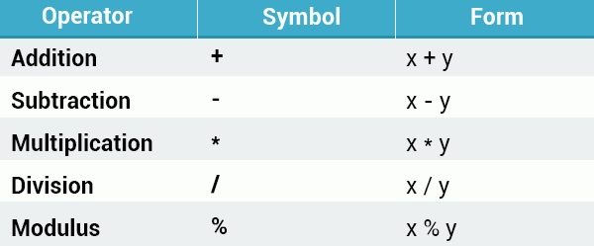
Operators
An operator is a symbol that performs mathematical or logical manipulations. Arithmetic Operators
C# supports the following arithmetic operators:

Slide 51
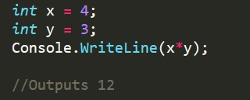
Operators
For example:
Tap Try It Yourself to play around with the code!

Slide 52
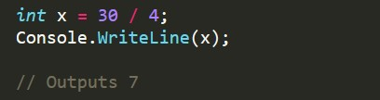
Division
The division operator (/) divides the first operand by the second. If the operands are both integers, any remainder is dropped in order to return an integer value. Example:
Division by 0 is undefined and will crash your program.

Slide 53
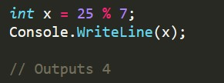
Modulus
The modulus operator (%) is informally known as the remainder operator because it returns the remainder of an integer division. For example:
Tap Try It Yourself to play around with the code!

Slide 54

Operator Precedence
Operator precedence determines the grouping of terms in an expression, which affects how an expression is evaluated. Certain operators take higher precedence over others; for example, the multiplication operator has higher precedence than the addition operator. For example:

Slide 55
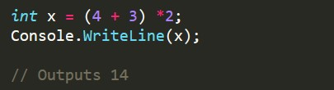
Operator Precedence
The program evaluates 3*2 first, and then adds the result to 4. As in mathematics, using parentheses alters operator precedence.
The operations within parentheses are performed first. If there are parenthetical expressions nested within one another, the expression within the innermost parentheses is evaluated first.

Slide 56
If none of the expressions are in parentheses, multiplicative (multiplication, division, modulus) operators will be evaluated before additive (addition, subtraction) operators. Operators of equal precedence are evaluated from left to right.

Slide 57
1.
Basic Concepts
Assignment & Increment Operators

Slide 58

Assignment Operators
The = assignment operator assigns the value on the right side of the operator to the variable on the left side. C# also provides compound assignment operators that perform an operation and an assignment in one statement. For example:
Tap Try It Yourself to play around with the code!

Slide 59

Assignment Operators
The same shorthand syntax applies to the multiplication, division, and modulus operators.

Slide 60

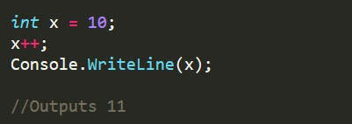
Increment Operator
The increment operator is used to increase an integer's value by one, and is a commonly used C# operator.
For example:

Slide 61



Prefix & Postfix Forms
The increment operator has two forms, prefix and postfix.
Prefix increments the value, and then proceeds with the expression. Postfix evaluates the expression and then performs the incrementing. Prefix example:
Postfix example:

Slide 62

Decrement Operator
The decrement operator (--) works in much the same way as the increment operator, but instead of increasing the value, it decreases it by one.

Slide 63
2.
Conditionals and Loops

Slide 64
2. Conditionals and Loops
The if-else Statement

Slide 65
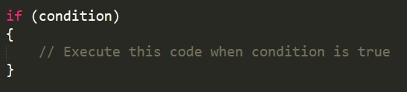
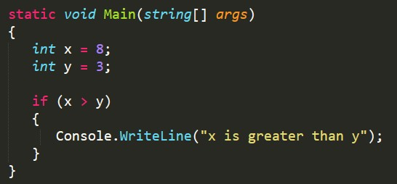
The if Statement
The if statement is a conditional statement that executes a block of code when a condition is true. The general form of the if statement is:
The condition can be any expression that returns true or false. For example:

Slide 66
The code above will evaluate the condition x > y. If it is true, the code inside the if block will execute.
When only one line of code is in the if block, the curly braces can be omitted. For example: if (x > y) Console.WriteLine("x is greater than y");

Slide 67
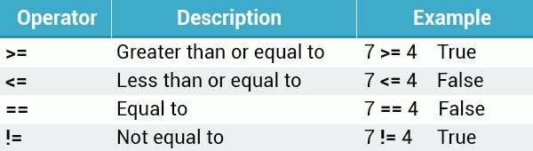
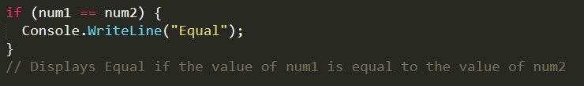
Relational Operators
Use relational operators to evaluate conditions. In addition to the less than (<) and greater than (>) operators, the following operators are available:
Example:

Slide 68
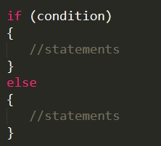
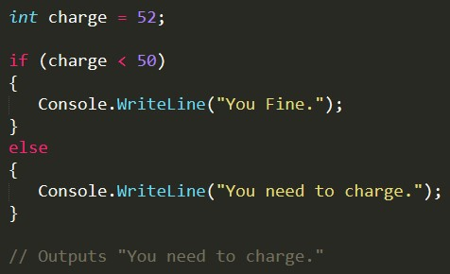
The else Clause
An optional else clause can be specified to execute a block of code when the condition in the if statement evaluates to false. Syntax:
Example:

Slide 69
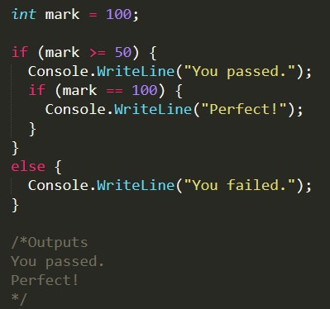
Nested if Statements
You can also include, or nest, if statements within another if statement. For example:

Slide 70
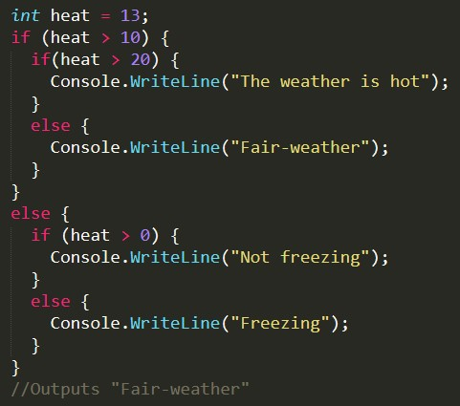
Nested if Statements
You can nest an unlimited number of if-else statements. For example:

Slide 71
Remember that all else clauses must have corresponding if statements.

Slide 72
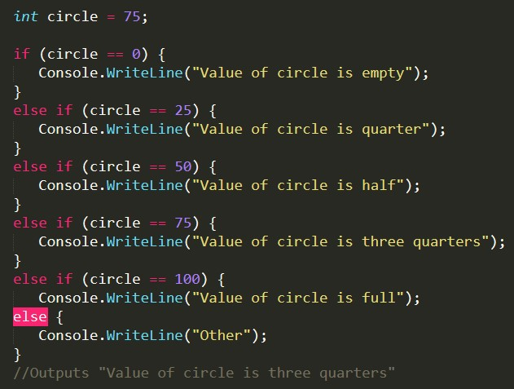
The if-else if Statement
The if-else if statement can be used to decide among three or more actions. For example:

Slide 73
Remember, that an if can have zero or more else if's and they must come before the last else, which is optional. Once an else if succeeds, none of the remaining else if's or else clause will be tested.

Slide 74
2. Conditionals and Loops
The switch Statement

Slide 75
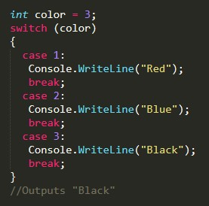
switch
The switch statement provides a more elegant way to test a variable for equality against a list of values. Each value is called a case, and the variable being switched on is checked for each switch case. For example:
Each case represents a value to be checked, followed by a colon, and the statements to get executed if that case is matched.

Slide 76
A switch statement can include any number of cases. However, no two case labels may contain the same constant value. The break; statement that ends each case will be covered shortly.

Slide 77
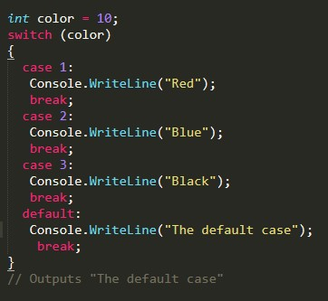
The default Case
In a switch statement, the optional default case is executed when none of the previous cases match. Example:
The default code executes when none of the cases matches the switch expression.

Slide 78
The break Statement
The role of the break statement is to terminate the switch statement. Without it, execution continues past the matching case statements and falls through to the next case statements, even when the case labels don’t match the switch variable. This behavior is called fallthrough and modern C# compilers will not compile such code. All case and default code must end with a break statement.
The break statement can also be used to break out of a loop.

Slide 79
2. Conditionals and Loops
The while Loop

Slide 80
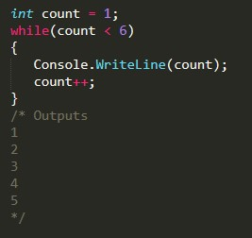
while
A while loop repeatedly executes a block of code as long as a given condition is true. For example : The example above declares a variable equal to 1 (int count = 1). The while loop checks the condition (count < 6) and, if true, executes the statements in its body, which increment the value of count by one, before checking the loop condition again. After the 5th iteration, count equals 6, the condition evaluates to false, and the loop stops running.

Slide 81
The loop body is the block of statements within curly braces.

Slide 82
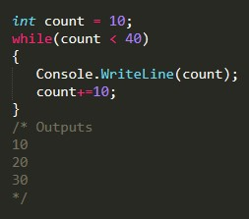
The while Loop
The compound arithmetic operators can be used to further control the number of times a loop runs. For example:
Without a statement that eventually evaluates the loop condition to false, the loop will continue indefinitely.

Slide 83
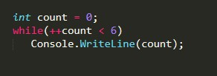
The while Loop
We can shorten the previous example, by incrementing the value of count right in the condition:
difference between while(count++ < 6) and while(++count < 6) : The loop while(++count < 6) will execute 5 times, because pre-increment increases the value of x before checking the count < 6 condition, while post-increment will check the condition before increasing the value of count, making while(count++ < 6) execute 6 times.

Slide 84
2. Conditionals and Loops
The for Loop

Slide 85

The for Loop
A for loop executes a set of statements a specific number of times, and has the syntax:
A counter is declared once in init. Next, the condition evaluates the value of the counter and the body of the loop is executed if the condition is true. After loop execution, the increment statement updates the counter, also called the loop control variable. The condition is again evaluated, and the loop body repeats, only stopping when the condition becomes false. For example:

Slide 86
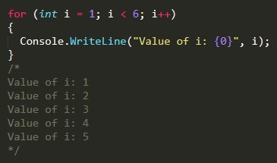
The for Loop
The condition is again evaluated, and the loop body repeats, only stopping when the condition becomes false. For example:

Slide 87
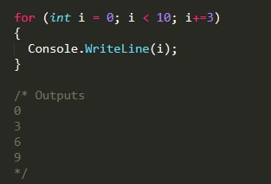
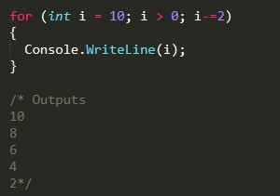
The for Loop
Compound arithmetic operators can be used to further control loop iterations. For example:
You can also decrement the counter:

Slide 88
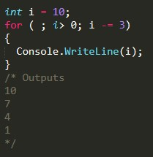
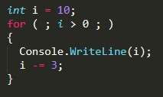
The for Loop
The init and increment statements may be left out, if not needed, but remember that the semicolons are mandatory. For example, the init can be left out:
You can have the increment statement in the for loop body:
for (; ;) {} is an infinite loop.

Slide 89
Class
A class is like a blueprint of specific object. In the real world, every object has some color, shape and functionalities. For example, the luxury car Ferrari. Ferrari is an object of the luxury car type. The luxury car is a class that specify certain characteristic like speed, color, shape, interior etc. So any company that makes a car that meet those requirements is an object of the luxury car type.

Slide 90
Class
For example, every single car of BMW, lamborghini, cadillac are an object of the class called 'Luxury Car'. Here, 'Luxury Car' is a class and every single physical car is an object of the luxury car class.
Likewise, in object oriented programming, a class defines certain properties, fields, events, method etc. A class defines the kinds of data and the functionality their objects will have.

Slide 91
Class
A class enables you to create your own custom types by grouping together variables of other types, methods and events.
In C#, a class can be defined by using the class keyword.

Slide 92
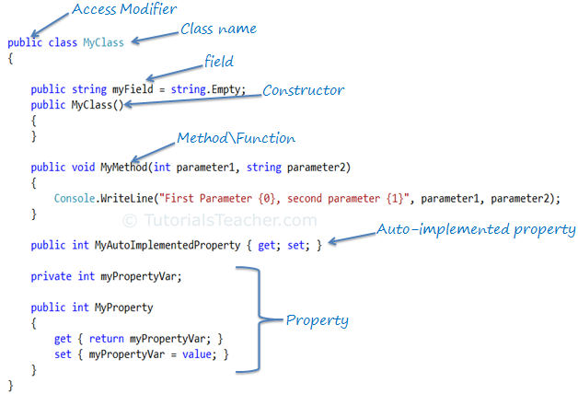

Slide 93
Access Modifiers
Access modifiers are applied on the declaration of the class, method, properties, fields and other members. They define the accessibility of the class and its members. Public, private, protected and internal are access modifiers in C#.

Slide 94
Field
Field is a class level variable that can holds a value. Generally field members should have a private access modifier and used with a property.

Slide 95
Constructor
A class can have parameterized or parameter less constructors. The constructor will be called when you create an instance of a class. Constructors can be defined by using an access modifier and class name: <access modifiers> <class name>(){ }

Slide 96
Method
A method can be defined using the following template:
{access modifier} {return type} MethodName({parameterType parameterName})

Slide 97
Property
A property can be defined using getters and setters, as below:
private int _myProperty;
public int MyProperty {
get { return _myProperty; }
set { _myPropertyVar = value; }
}

Slide 98
Property
Property encapsulates a private field. It provides getters (get{}) to retrieve the value of the underlying field and setters (set{}) to set the value of the underlying field. In the above example, _myPropertyVar is a private field which cannot be accessed directly. It will only be accessed via MyProperty. Thus, MyProperty encapsulates _myPropertyVar.

Slide 99
Property
You can also apply some addition logic in get and set, as in the below example.
private int _myProperty;
public int MyProperty {
get { return _myProperty / 2;
}
set { if (value > 100) _myProperty = 100;
else _myProperty = value; ; }
}

Slide 100
Auto-implemented Property
property declaration has been made easy if you don't want to apply some logic in get or set.
The following is an example of an auto-implemented property:
public int MyAutoImplementedProperty { get; set; }

Slide 101
Auto-implemented Property
Notice that there is no private backing field in the above property example. The backing field will be created automatically by the compiler. You can work with an automated property as you would with a normal property of the class. Automated-implemented property is just for easy declaration of the property when no additional logic is required in the property accessors.

Slide 102
Tuple
The Tuple<T> class was introduced in .NET Framework 4.0. A tuple is a data structure that contains a sequence of elements of different data types. It can be used where you want to have a data structure to hold an object with properties, but you don't want to create a separate type for it.
Tuple<T1, T2, T3, T4, T5, T6, T7, TRest>

Slide 103
Tuple
The following example creates a tuple with three elements:
In the above example, we created an instance of the Tuple which holds a record of a person. We specified a type for each element and passed values to the constructor. Specifying the type of each element is cumbersome.
Tuple<int, string, string> person = new Tuple <int, string, string>(1, "Steve", "Jobs");

Slide 104
Tuple
So, C# includes a static helper class Tuple which returns an instance of the Tuple<T> without specifying the type of each element, as shown below.
A tuple can only include maximum eight elements. It gives a compiler error when you try to include more than eight elements.
var person = Tuple.Create(1, "Steve", "Jobs");

Slide 105
The this Keyword
C# supports this keyword which provides access to the current class instance. One of uses of this keyword is to resolve scope ambiguity, which can arise when an incoming parameter is named identically to a data field of the type.

Slide 106
Constructor Chaining with this keyword
Another way of using this keyword is to design a class using constructor chaining. This is helpful when we have a class that defines multiple constructors. Given the fact that constructors often validate the incoming arguments to enforce various rules, it can be common to find redundant validation logic within a class's constructor set.

Slide 107
Constructor Chaining with this keyword
Another approach is to designate the constructor that takes the greatest number of argumentsas the master constructor and have its implementation perform the required validation logic. The remaining constructors can use this keyword to forward the incoming arguments to the master constructor and provide any additional parameters as necessary. In this way, we only need to worry about maintaining a single constructor for the entire class while the remaining constructors are empty.

Slide 108
Thanks!
Any questions?
You can find me at:
@username
user@mail.me

